Slide 1
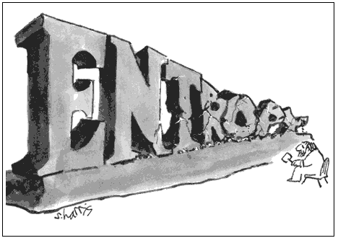

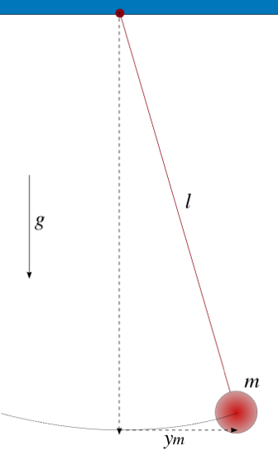
THE SECOND LAW SEEN FROM CLASSICAL MECHANICS
Peter Salamon
CSRC December 3, 2010
Notes:
Try to be a little more didactic than usual for a colloquium in light of the fraction of students present.
----- Meeting Notes (12/3/10 00:06) -----

Slide 2
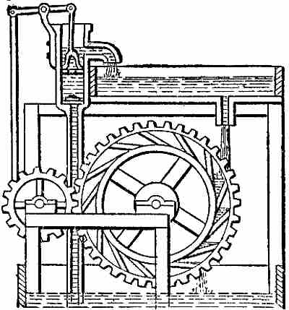
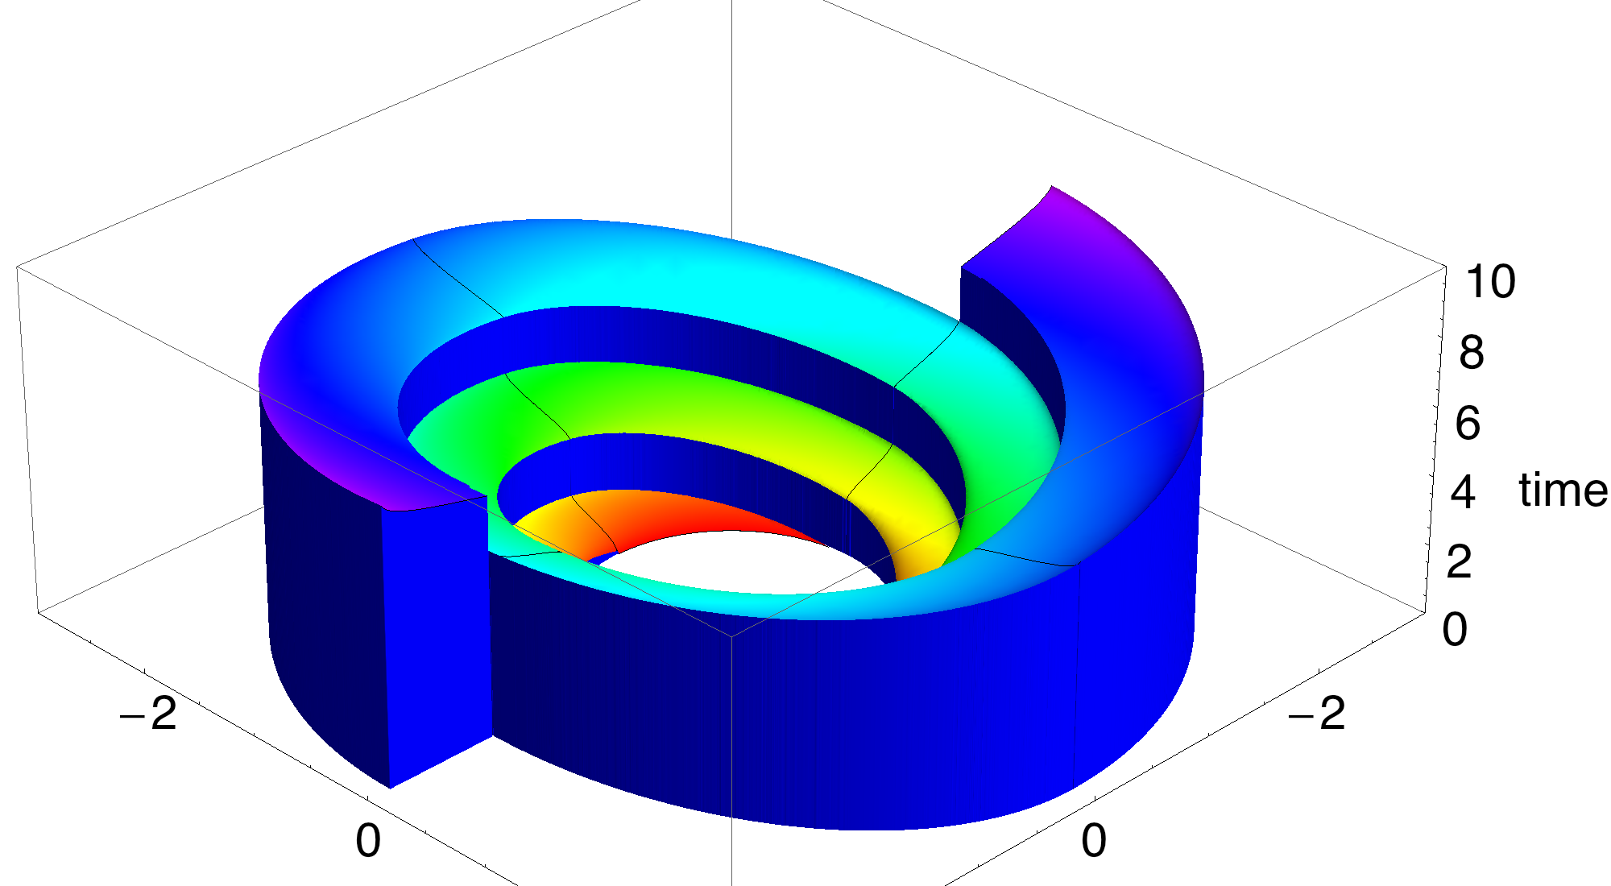


Outline
Thermodynamics
  Second Law
Classical Mechanics
  Harmonic Oscillator
  Collection of harmonic oscillators
Optimal Control
The Surprising Finding
One-upmanship
Notes:
One slide courses in Thermo/Mechanics/Optimal Control
----- Meeting Notes (12/3/10 00:06) -----

Slide 3
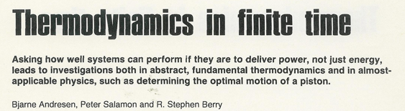
Thermodynamics
Physics
Gambling
1st Law | Conservation of energy | You can’t win
2nd Law | Heat flows from hot to cold | You can’t break even
3rd Law | Can’t reach T=0 | You can’t get out of the game

Slide 4
The Second Law
Heat flows from hot to cold.
It is impossible for the reverse to happen (without other compensating events) no matter what mechanism is employed.
  Patent office

Slide 5

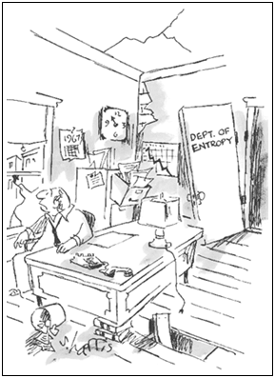
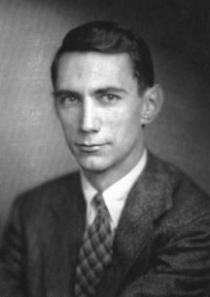
Entropy
There exists a function of state, entropy, which is conserved in reversible processes and increases in irreversible processes.
  S = function mathematized to increase
2nd
Law
Boltzmann
Shannon

Slide 6
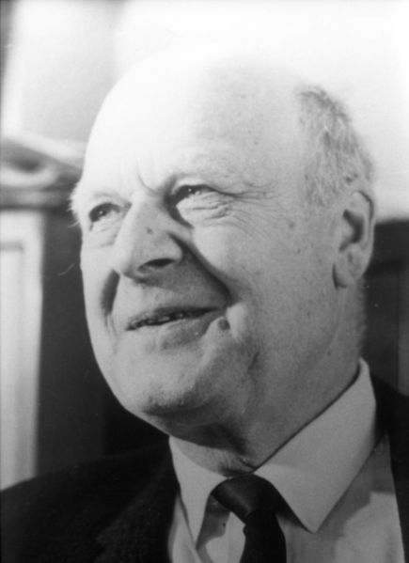
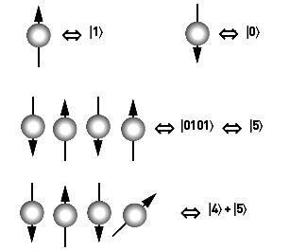
Age of Information
Principle of Microscopic Reversibility
Quantum computing and related experiments where small systems with complete information interact. Single molecule experiments, …
  Reversible mechanics works; do not see irreversibility. Experiments match predictions of Hamiltonian calculations.
Notes:
and would like to respect

Slide 7
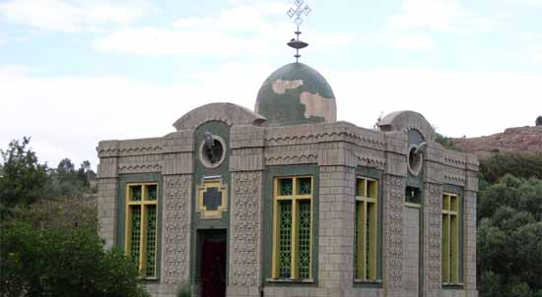
Modern Views?
Hence several physicists I know think we just lose track of (or cannot track) each particle and all of its interactions. This is all there is to increase of entropy.
Ignoring open quantum systems
Church of the
Hamiltonian

Slide 8
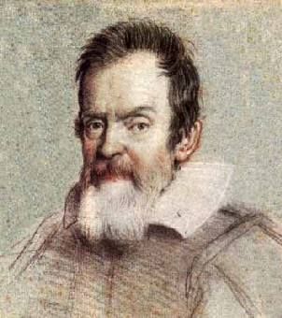
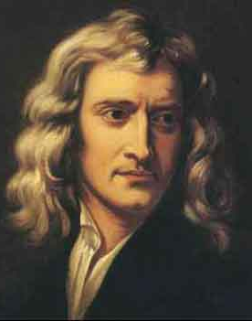
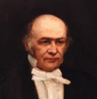

Classical Mechanics
Hopelessly complicated until Galileo took friction out
  Made mechanics reversible
Newton
Hamilton
Lagrange
Notes:
Without friction perpetuum mobiles are possible (try selling one to the patent office)

Slide 9
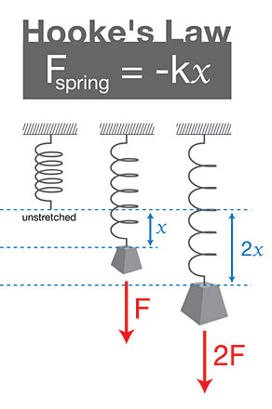
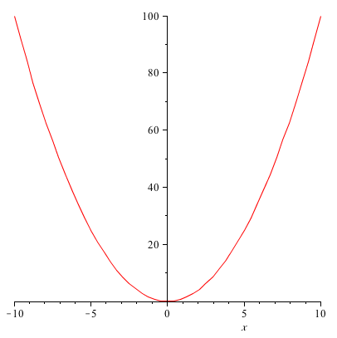
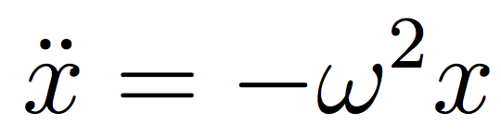
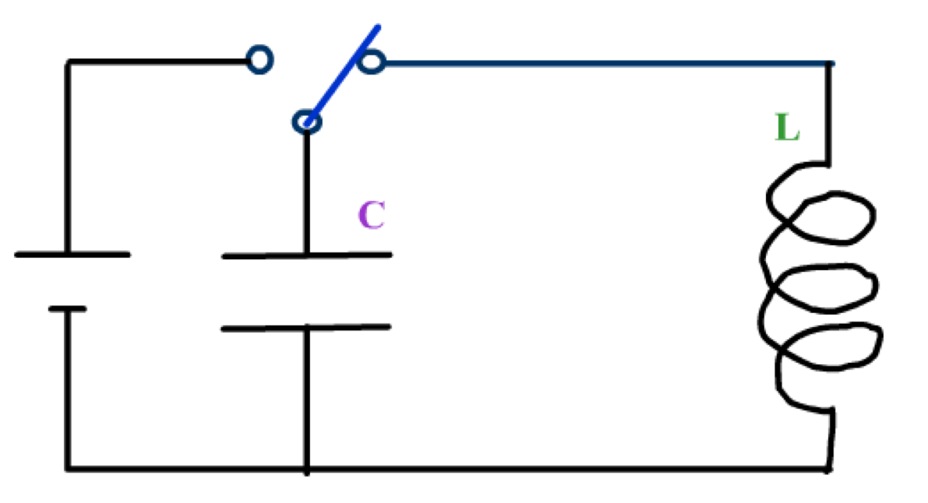
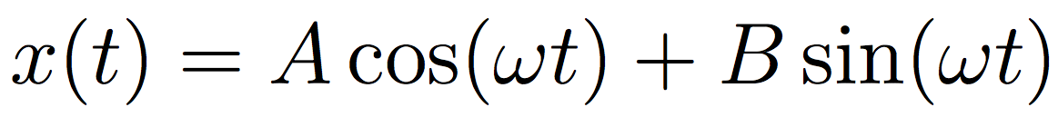
The harmonic oscillator
Hooke’s Law
Spring
Pendulum
Parabolic Potential
LC
circuit
Notes:
M=1

Slide 10

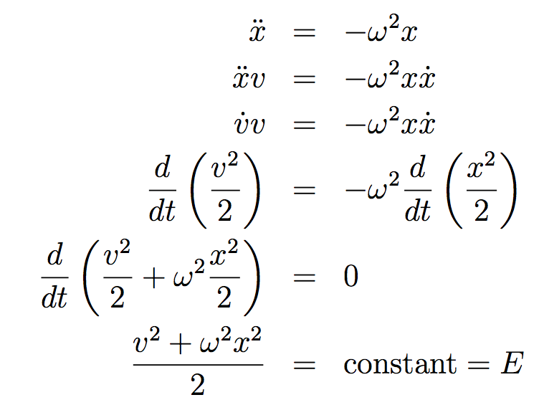
Conservation of Energy
Ellipses in (x,v) space.
Notes:
M=1

Slide 11
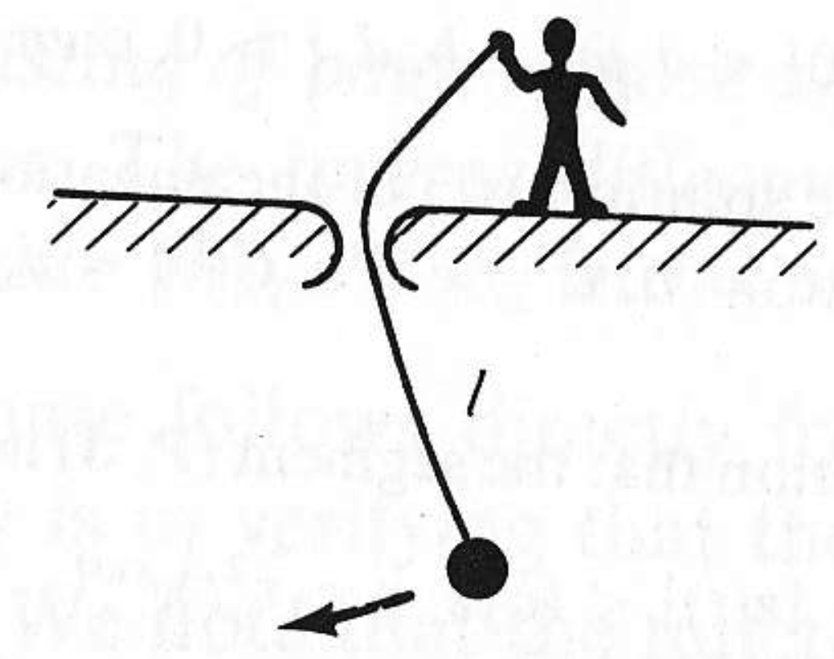
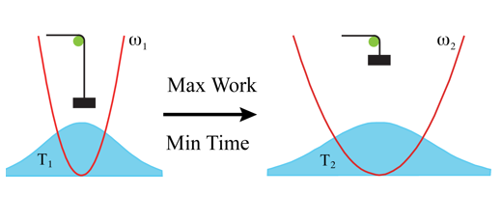
The Problem
?
How best to change

Slide 12
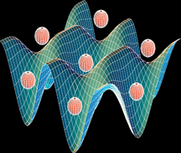
Actually Interested in
Many Harmonic Oscillators
Optimization problem: Cool atoms in an optical lattice. Created by lasers and have easily controlled ω.

Slide 13
The Solution – one oscillator
p
q

Slide 14
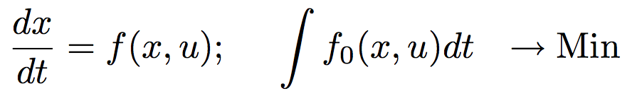
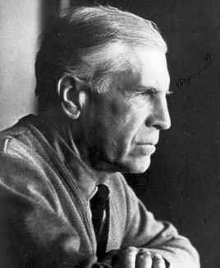

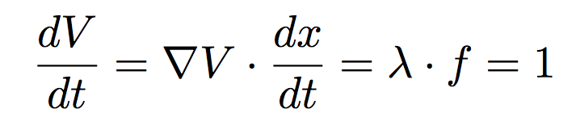
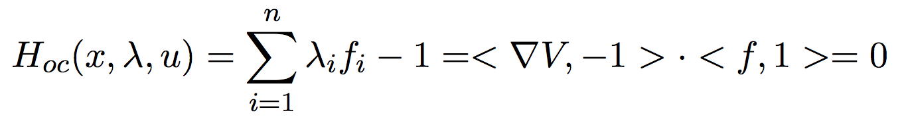
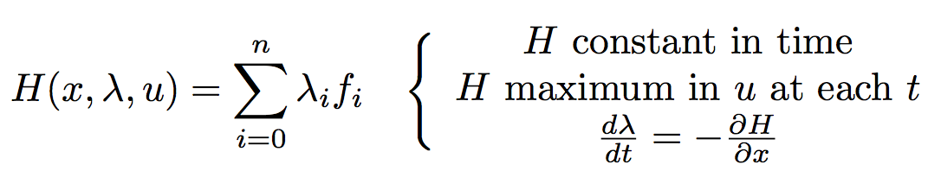
Optimal Control
Optimality condition: Stay on surface of minimum final cost.

Slide 15
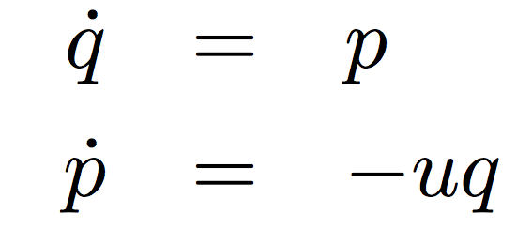
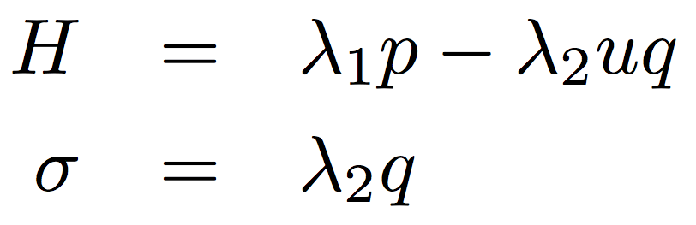
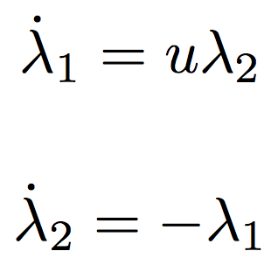
Classical Harmonic Oscillator
Bang-Bang Control Problem
= switching function
> 0; u=u_{Max}
< 0; u=u_{Min}

Slide 16
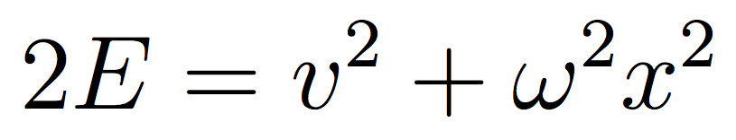
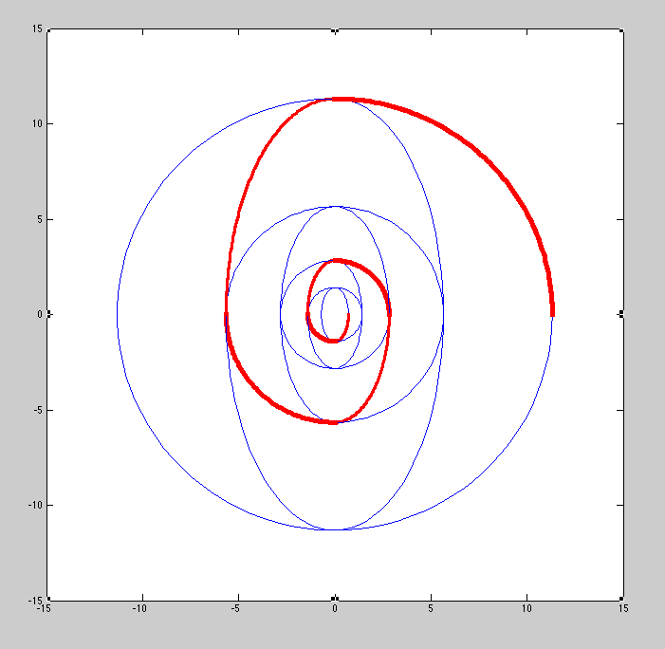
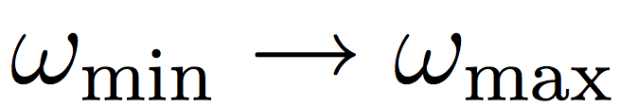
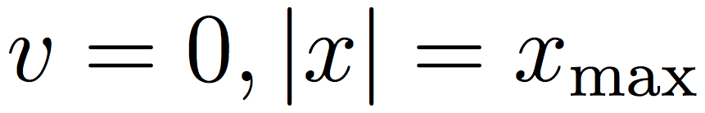
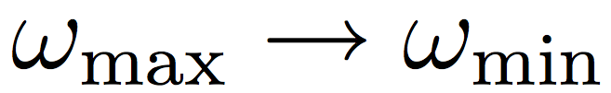
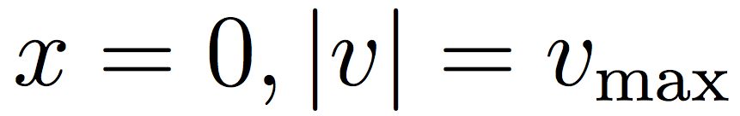
The physical solution
Fastest growth in
v
by switching
when
x
and
when
Notes:
Squeezed light

Slide 17
Optimal cooling trajectories
Notes:
The math solution

Slide 18
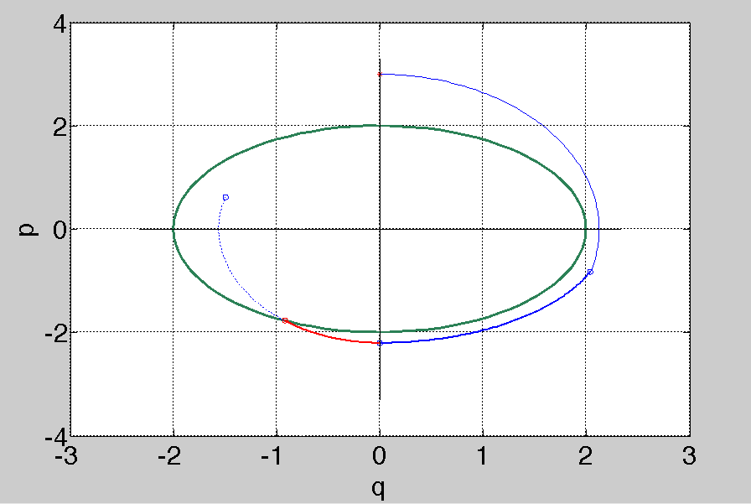
Tradeoff for last leg
Notes:
If you go around many times, or just trying to reach apex, the effect is small.

Slide 19
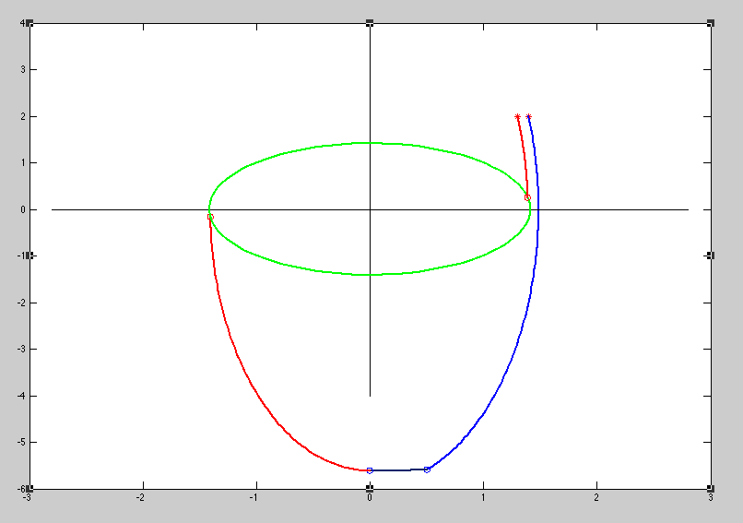
Discontinuities are real

Slide 20
The Real Problem
?
How best to change

Slide 21

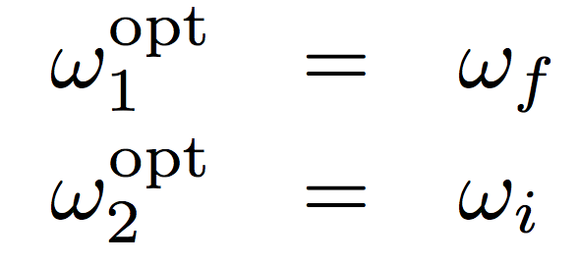
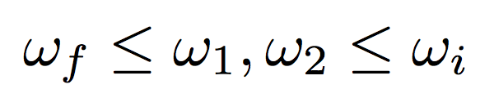
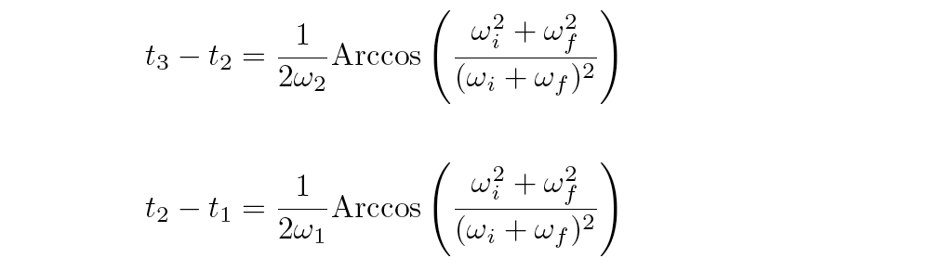
Best Control
Total time on the order of one oscillation !!!
t₁
t₂
t₃
ω_{f}
ω_{i}
ω

Slide 22
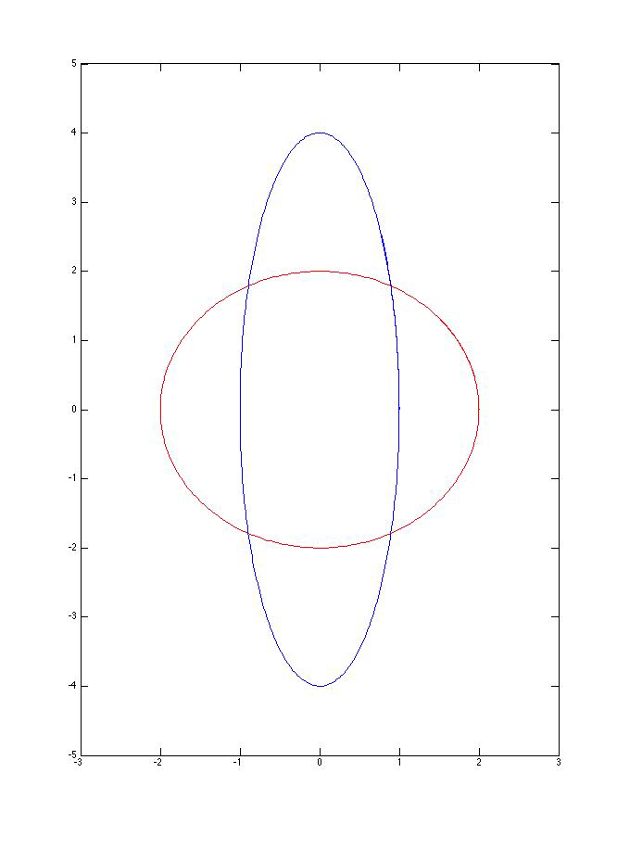
The Best Control
Microcanonical Ensemble

Slide 23
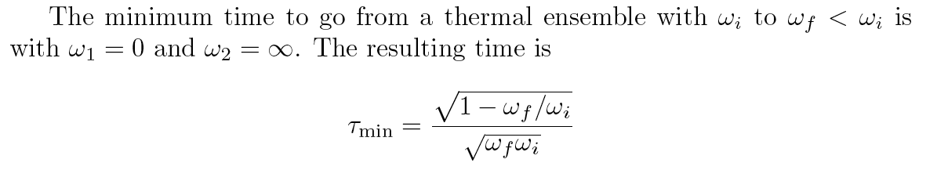
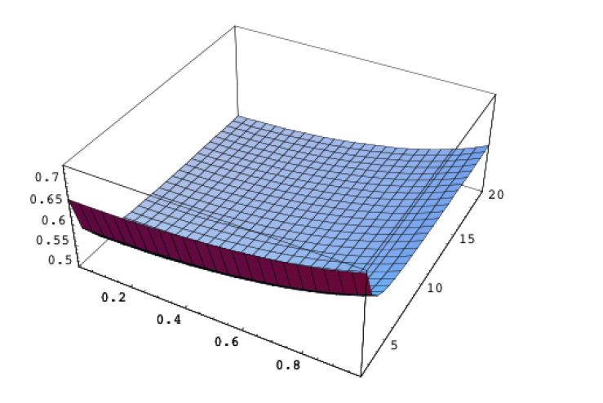
Minimum Time
τ
ω₂
ω₁

Slide 24

Definition
A prelude process is a reversible process performed as a prelude to a thermal process.
Gives a view of the second law from classical mechanics.
Notes:
Draw some general lessons

Slide 25
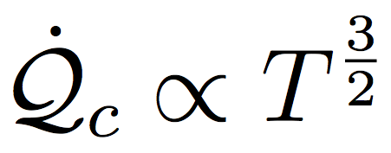
The Magic
Fast(est) adiabatic switching.
Can only extract the full maximum work available from the change if
time > min time
else must create parasitic oscillations.
-- New type of finite-time Availability
Time limiting branch in a heat cycle to cool system toward T=0.
  Implies

Slide 26
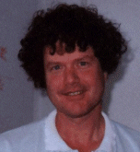
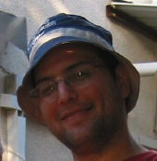
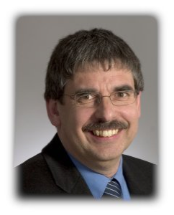
"The Quantum Refrigerator: The quest for absolute zero",
Y. Rezek, P. Salamon, K.H. Hoffmann, and R. Kosloff,
Europhysics Letters, 85, 30008 (2009)
"Maximum Work in Minimum Time from a Conservative Quantum System",
P.Salamon, K.H. Hoffmann, Y. Rezek, and R. Kosloff,
Phys. Chem. Chem. Phys., 11, 1027-1032 (2009)

Slide 27
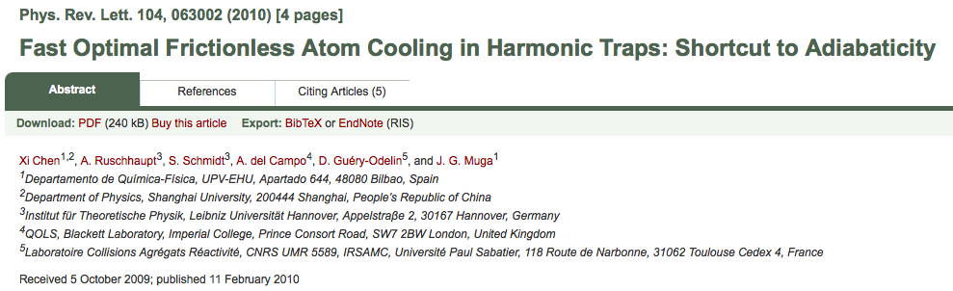
Going even faster
Turns out we stopped too soon
  Letting become imaginary ( become negative)
  gives faster adiabatic processes!
“The cooling times achieved are shorter than those obtained using optimal-control bang-bang methods and real frequencies.”
Notes:
Chin asked imaginary omega

Slide 28
Recap Outline
Thermodynamics
  Second Law
Classical Mechanics
  Harmonic Oscillator
  Collection of harmonic oscillators
Optimal Control
The Surprising Finding
One-upmanship
Notes:
One slide courses in Thermo/Mechanics/Optimal Control

Slide 29


Slide 30
Reversible processes
No friction
T₁=T₂
p₁=p₂
μ₁=μ₂
Reversible processes act transitively on the set of states of a system
Needs work and heat reservoirs
Transport infinitely slow
Not gonna see them in a beaker or in a cell.

Slide 31
Abstract
The talk will survey modern views of the second law of thermodynamics and claim that it holds even if physicists have stopped believing in it. It will also review some surprising recent findings regarding the second law of thermodynamics when applied to an optimally controlled collection of harmonic oscillators. Even within the reversible framework of classical mechanics, the best control leads to irreversibility if not enough time is alloted. The findings have implications for the attainability of absolute zero and for our understanding of irreversibility in physical processes.

Slide 32
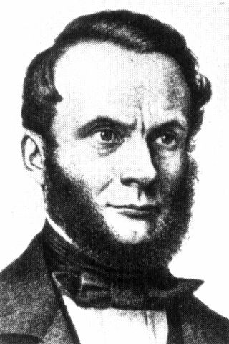
Some Etymology
en ergy
  ergos = work (from mechanics)
  work content
en tropy
  tropos = change, turn
  change content
  discounted-work-producing content
  function mathematized to increase
Notes:
I am assuming Mathy audience

Slide 33


